Slide 1
A Guide to S Q L, Tenth Edition
Chapter 3
Creating Tables

Slide 2
Objectives
Create and run S Q L commands
Create and activate a database
Create tables
Identify and use data types to define columns in tables
Understand and use nulls
Add rows to tables
View table data
Correct errors in a table
Save S Q L commands to a file
Describe a table’s layout using S Q L

Slide 3
Introduction
Structured Query Language (S Q L)
One of the most popular and widely used languages for retrieving and manipulating database data
Developed in the mid-1970s under the name SEQUEL
Renamed S Q L in 1980
Used by most database management systems (DBMS)

Slide 4
Creating and Running S Q L Commands
Can be done by using a DBMS that supports S Q L to accomplish tasks
My S Q L 8.0 (My S Q L Community Server 8.0.18) installation
Suggested setup types: Developer default type and full type
Both include the installation of the My S Q L Workbench
My S Q L Workbench contains:
Powerful tools that allow developers and database administrators to visually design, develop, and administer My S Q L databases
An S Q L editor that is used throughout the text to enter commands and view the results of the commands entered
Users should make sure they remember the password selected during installation

Slide 5
Using My S Q L Workbench
Run My S Q L Workbench 8.0 C E app after My S Q L 8.0 is installed
Access the main My S Q L Workbench environment for the listed connection via the server created during installation
By clicking the available connection box listed on the My S Q L Workbench opening window and then submitting the password
Simplify the main window to give more room for the Query pane and Output pane
By hiding Navigation pane and My S Q L Additions pane

Slide 6
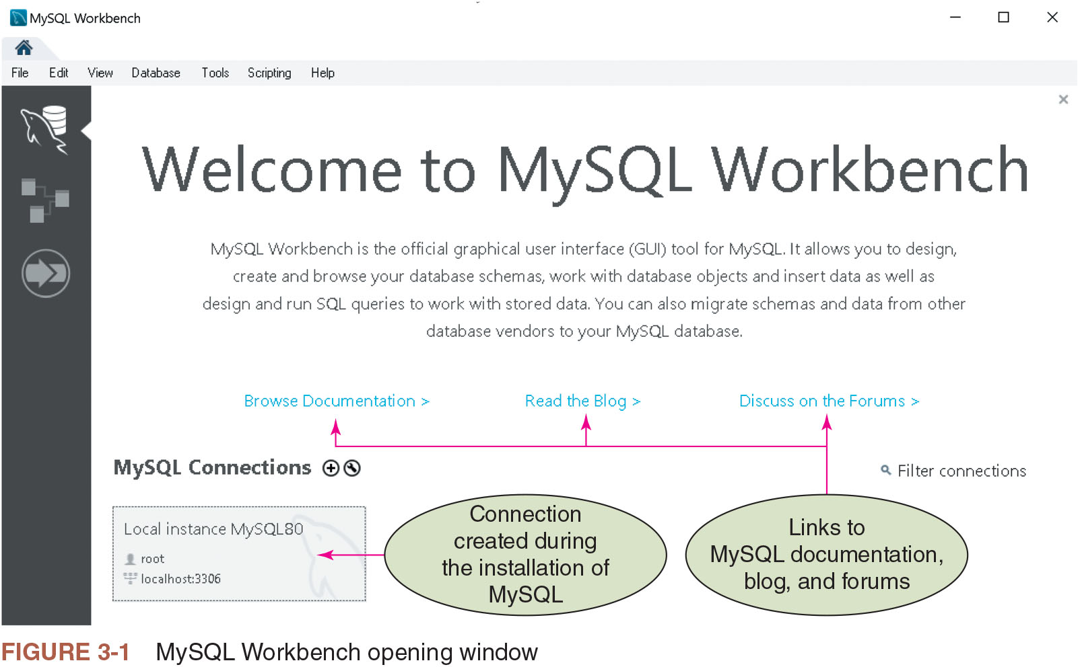
Figure 3-1: My S Q L Workbench Opening Window

Slide 7
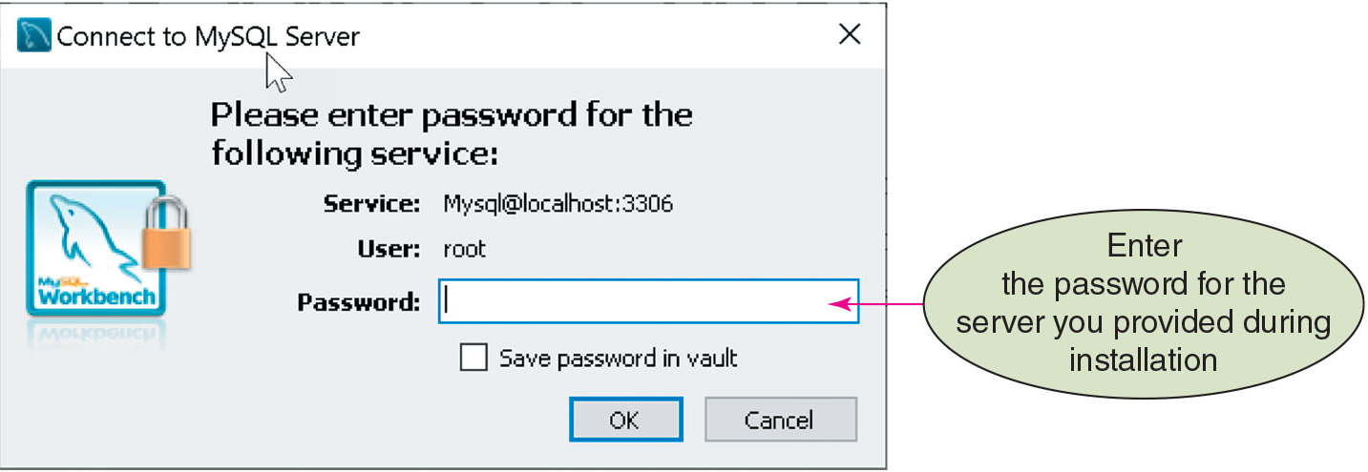
Figure 3-2: Entering Password for Server

Slide 8
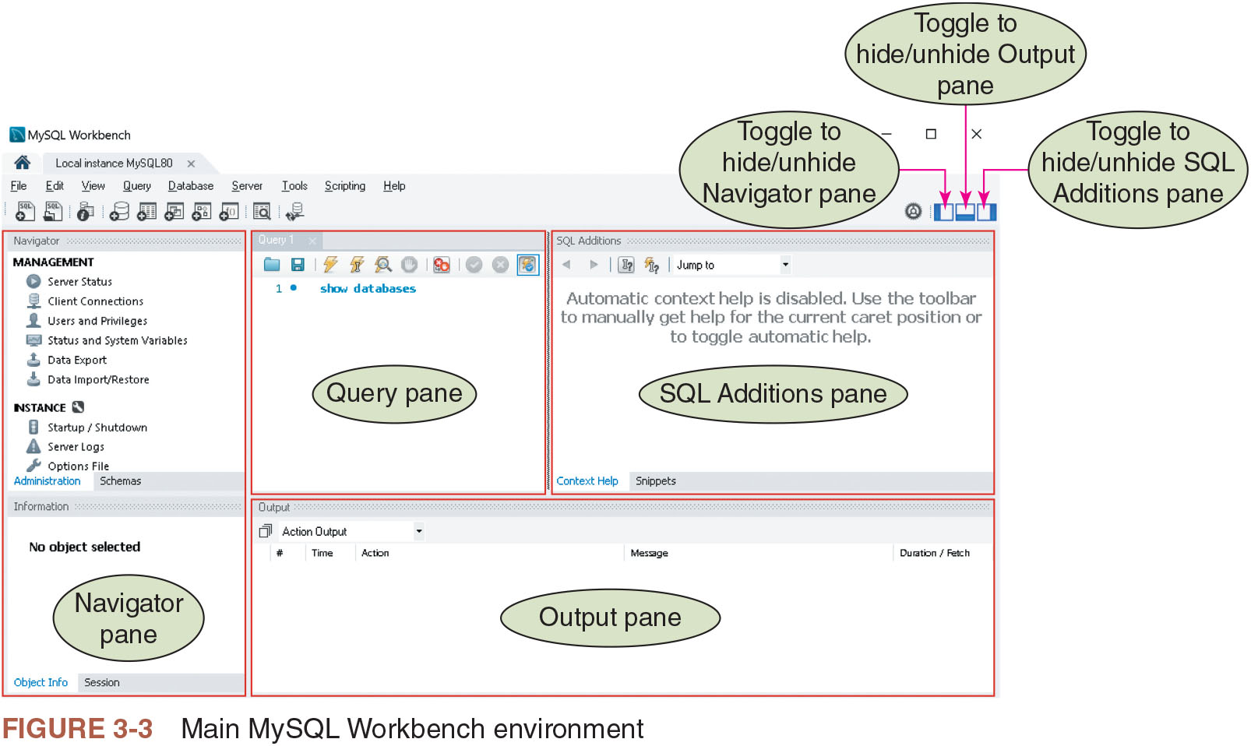
Figure 3-3: Main My S Q L Workbench Environment

Slide 9
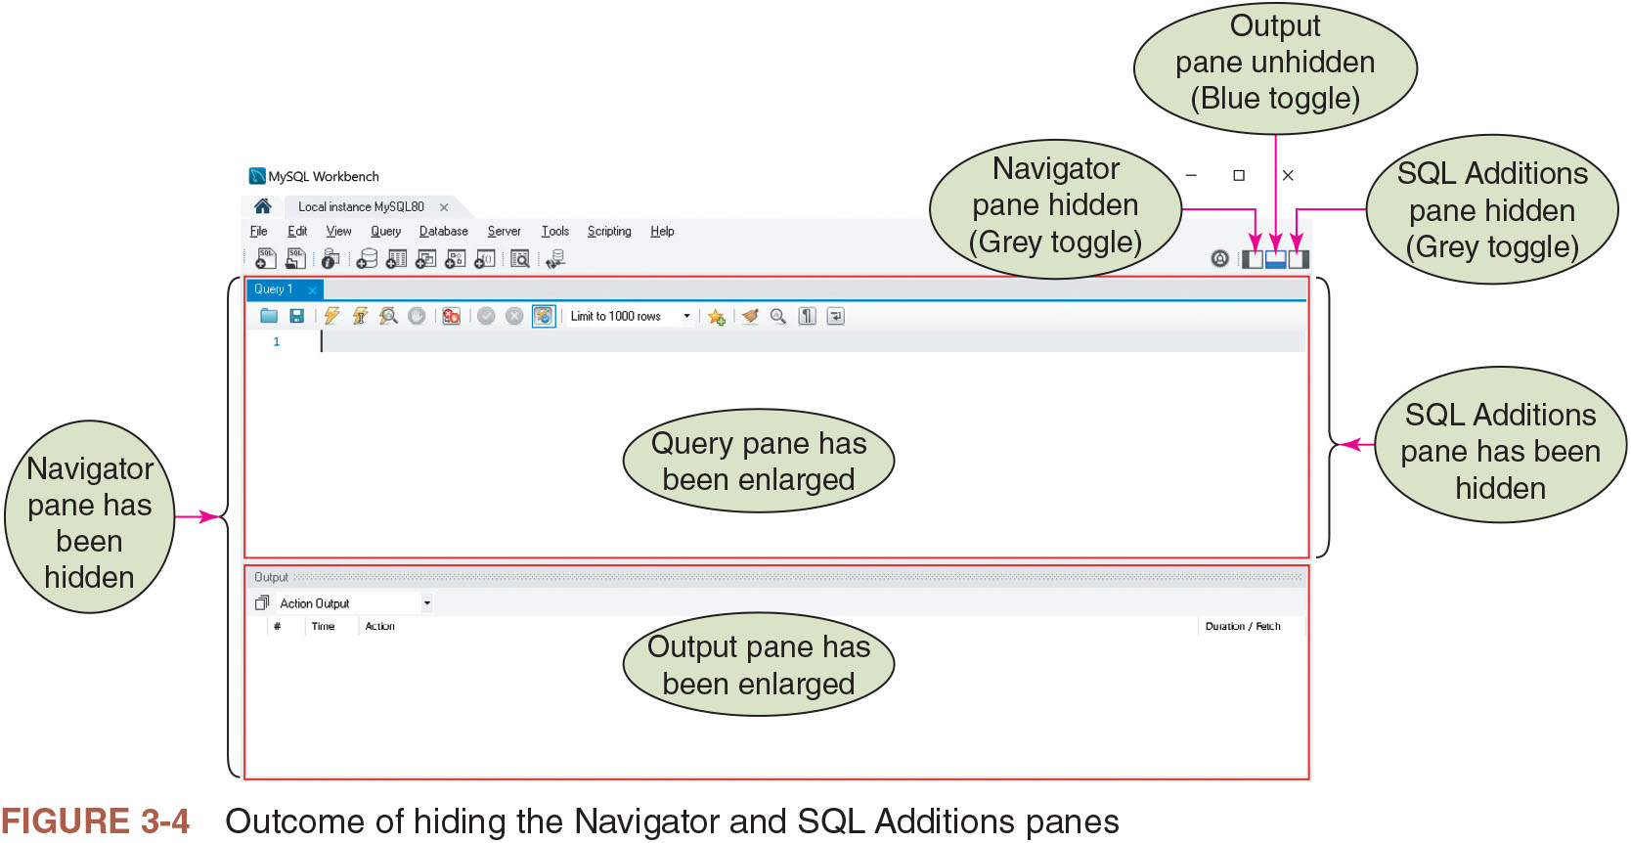
Figure 3-4: Outcome of Hiding the Navigator and S Q L Additions Panes

Slide 10
Entering Commands
Commands
Followed by a semicolon
Semicolon ends a statement in S Q L
Entered into the My S Q L Workbench S Q L editor
Microsoft has a specific system of identifying keywords
Executed by selecting Execute Current Statement or Execute (All or Selected) from the Query menu
Displays a result grid between the query pane and output pane
Result grid and details from output pane can be cleared
History of processing commands can be accessed
Cleared by highlighting and deleting them

Slide 11
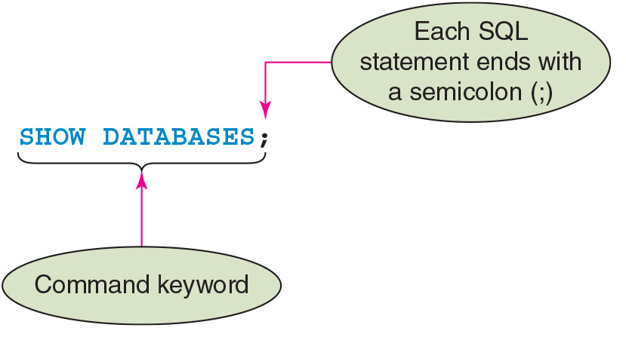
Figure 3-5: Syntax of the SHOW DATABASES Command

Slide 12
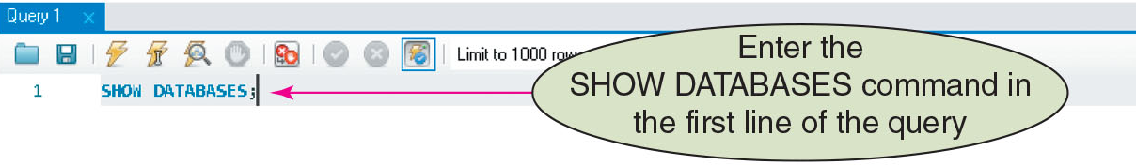
Figure 3-6: Enter SHOW DATABASES Command

Slide 13
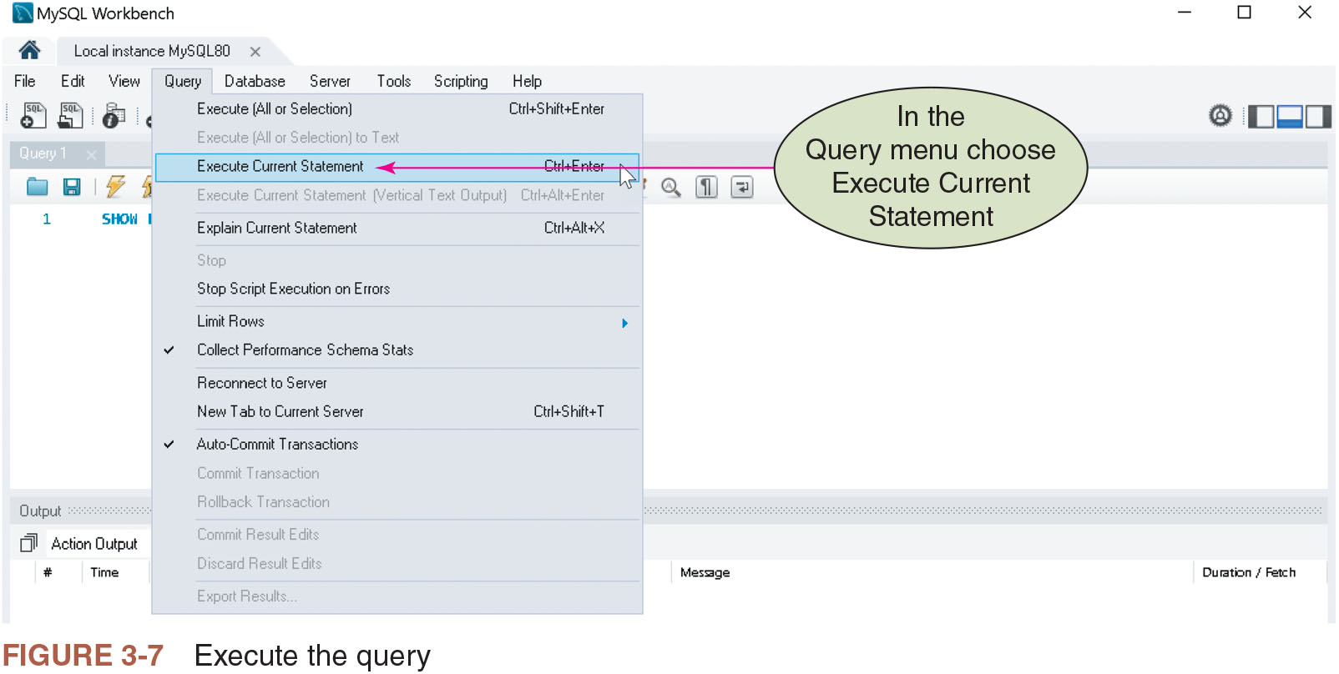
Figure 3-7: Execute the Query

Slide 14
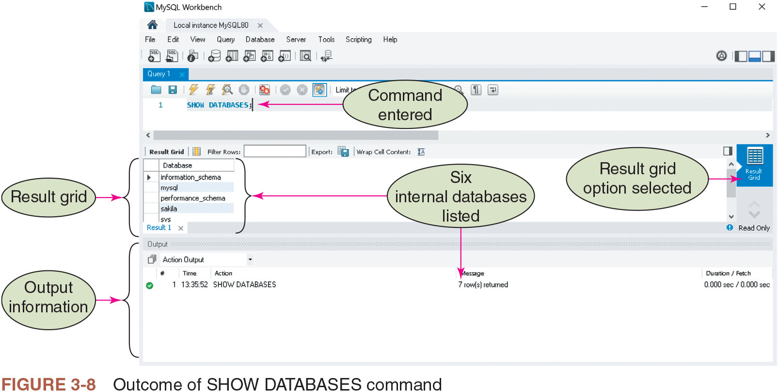
Figure 3-8: Outcome of SHOW DATABASES Command

Slide 15
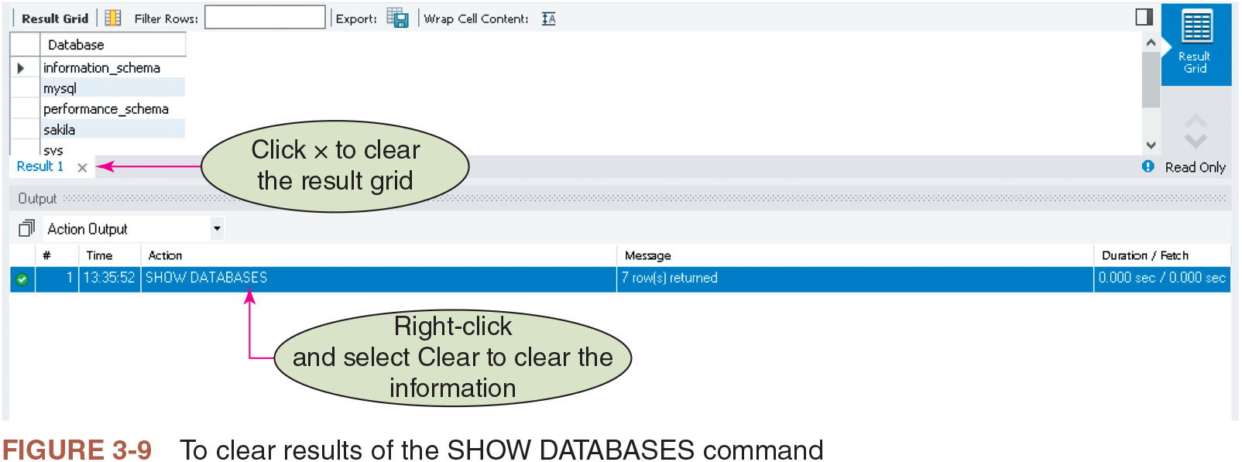
Figure 3-9: To Clear Results of the SHOW DATABASES Command

Slide 16
Creating a Database (1 of 2)
Objects within a database have identifiers, or names, associated with them
DBMS rules for naming identifiers vary
General guidelines for naming identifiers when using a DBMS
The identifier name:
Cannot exceed 30 characters
Must start with a letter
Can contain letters, numbers, and underscores (_)
Cannot contain spaces

Slide 17
Creating a Database (2 of 2)
Steps involved
Enter the command keyword followed by the desired name of database and end with semicolon
Execute the command
Execute the command to list databases
Results in six internal databases and one additional database that was created with the desired name

Slide 18
Changing the Default Database
Known as activating or using the database
Default database must be set to the database one wants to work with
Default database is the one to which all subsequent commands pertain
Activate the default database
By executing the USE command followed by the name of the database
Tables can be added to the database after it has been activated

Slide 19
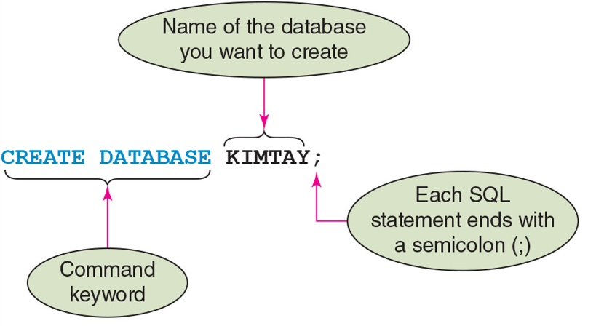
Figure 3-10: Syntax of the CREATE DATABASE Command

Slide 20
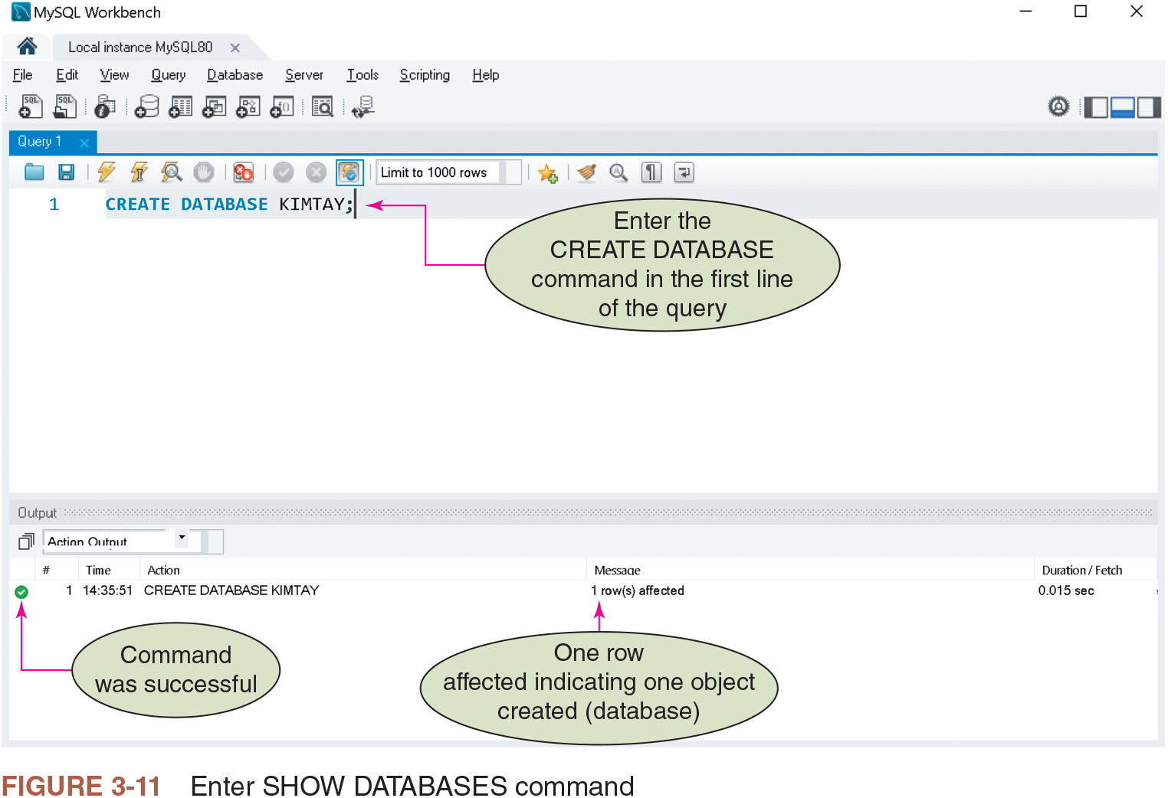
Figure 3-11: Enter SHOW DATABASES Command

Slide 21
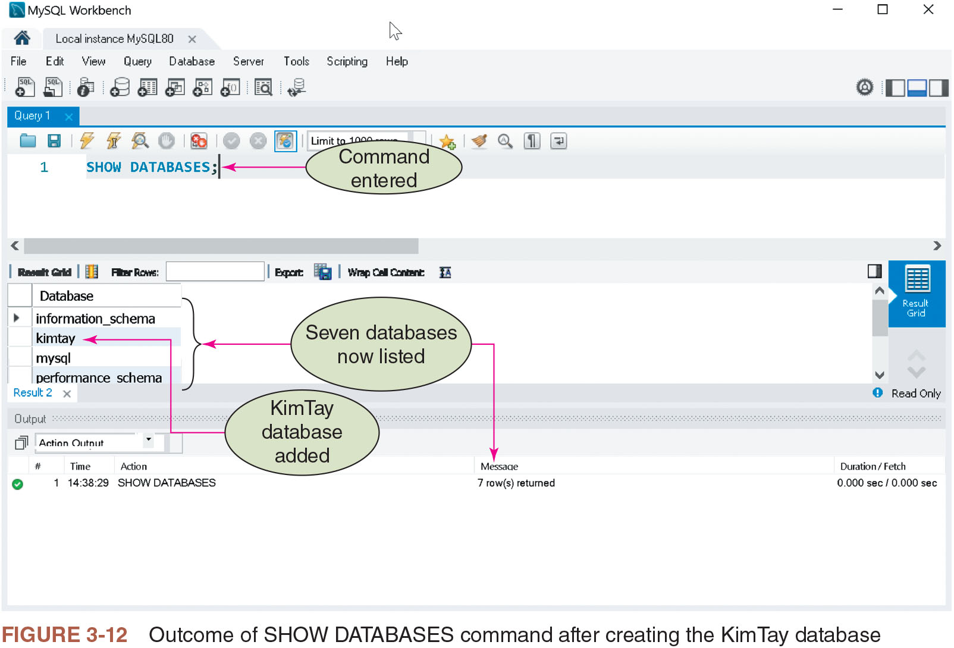
Figure 3-12: Outcome of SHOW DATABASES Command after Creating the KimTay Database

Slide 22
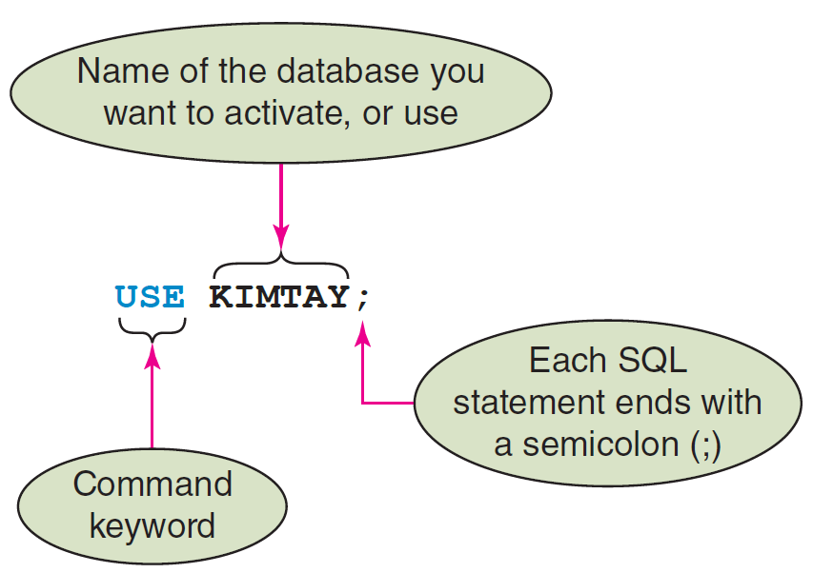
Figure 3-13: Syntax of the USE Command

Slide 23
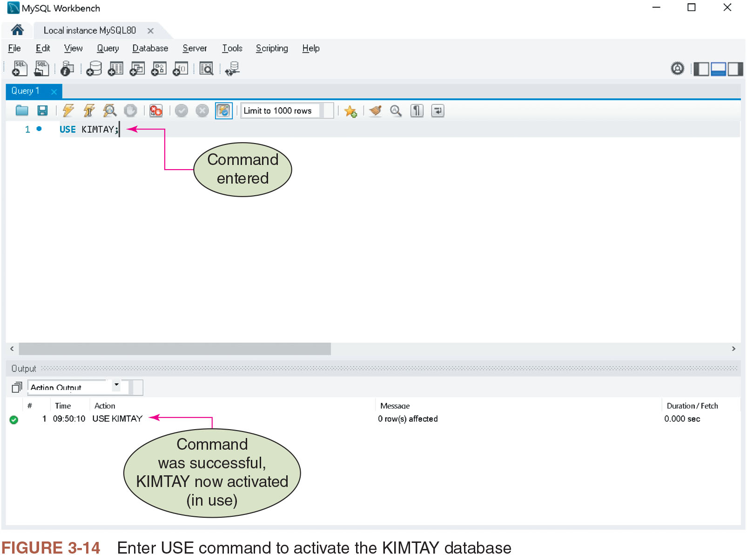
Figure 3-14: Enter USE Command to Activate the KIMTAY Database

Slide 24
Creating a Table (1 of 2)
Describe the layout of the table in the database
Use the CREATE TABLE command followed by:
Table name
Names and data types of the columns in the table
Data types: Define the type of data and the number of characters or digits stored in each column of data

Slide 25
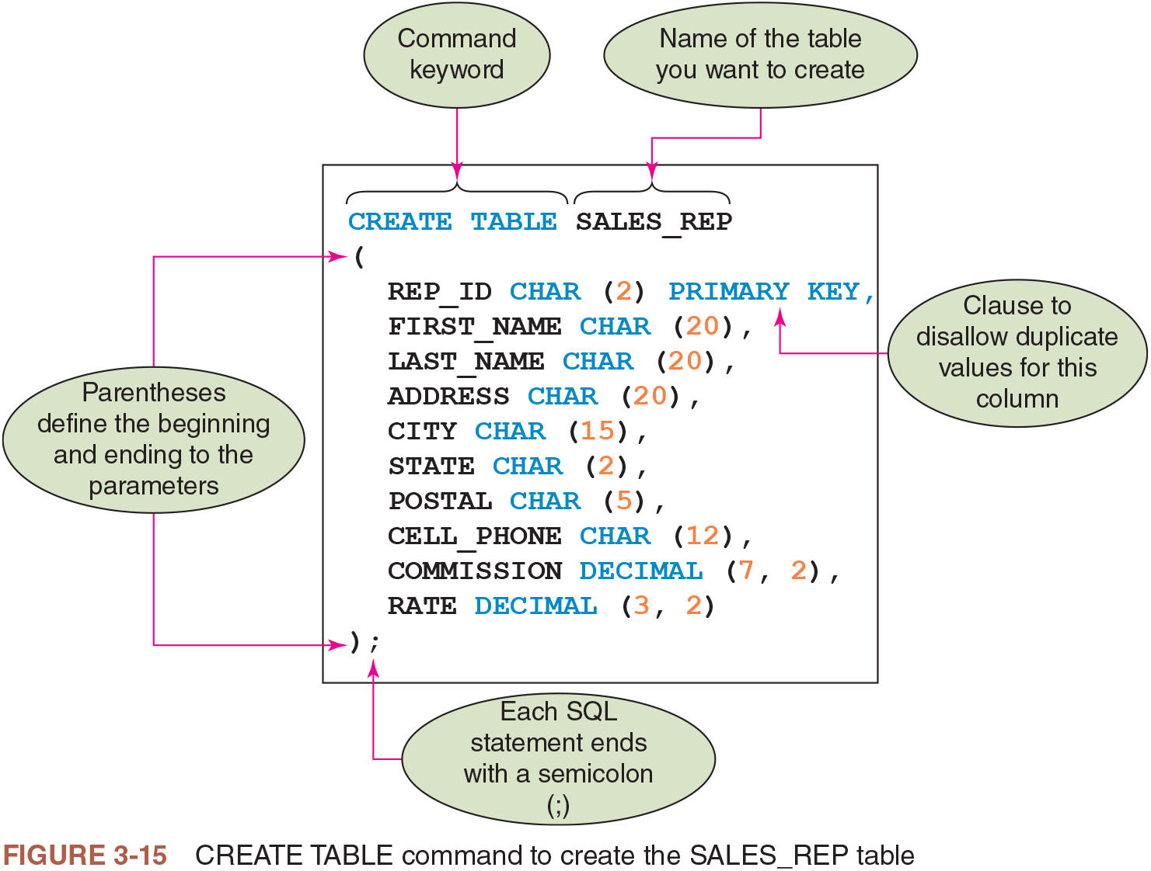
Figure 3-15: CREATE TABLE Command to Create the SALES_REP Table

Slide 26
Creating a Table (2 of 2)
Commands are free format
No rules stating specific words in specific positions
Commands are not case sensitive
Exception: Use the correct case when inserting values into a table

Slide 27
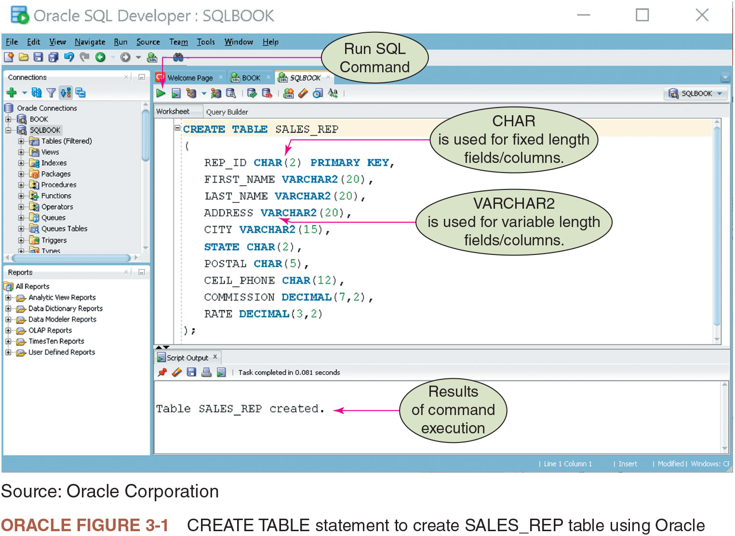
Oracle Figure 3-1: CREATE TABLE Statement to Create SALES_REP Table Using Oracle

Slide 28
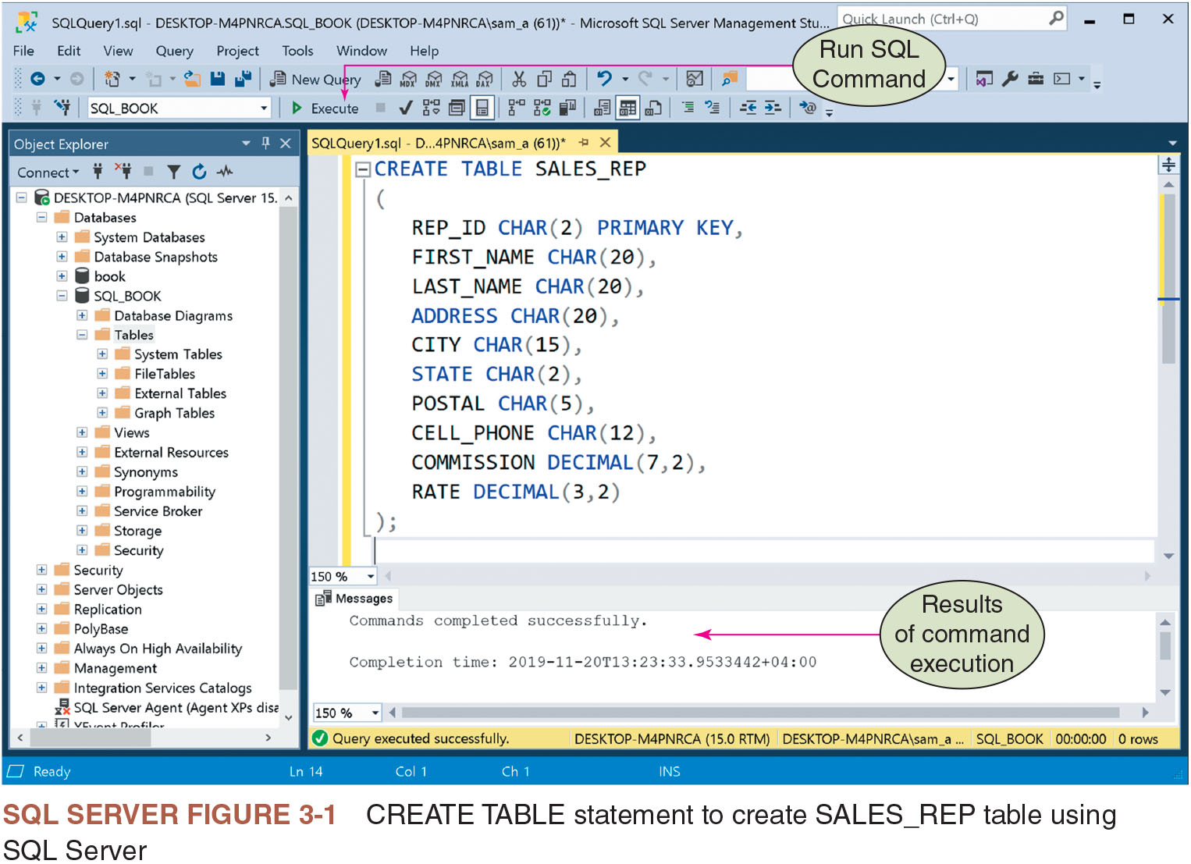
S Q L Server Figure 3-1: CREATE TABLE Statement to Create SALES_REP Table Using S Q L Server

Slide 29
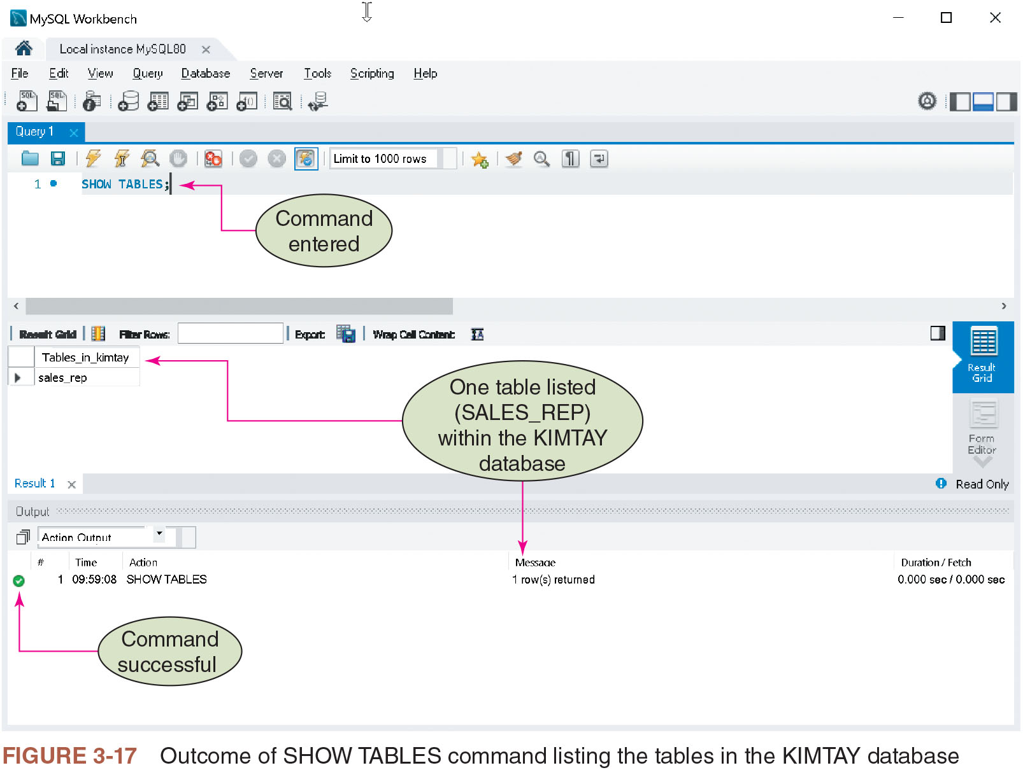
Figure 3-17: Outcome of SHOW TABLES Command Listing the Tables in the KIMTAY Database

Slide 30
Correcting Errors in S Q L Commands
Use the same techniques that you might use in a word processor
Make changes and click the Run button to execute the command again

Slide 31
Dropping a Table
Errors in tables can be corrected by dropping (deleting) and starting over
Useful when a table is created before errors are discovered
Command is followed by the table to be dropped and a semicolon
Data in the table will also be deleted

Slide 32
Using Data Types
For each column, the type of data must be defined
Common data types
CHAR(n)
VARCHAR(n)
DATE
DECIMAL(p,q)
INT
SMALLINT

Slide 33
Using Nulls (1 of 2)
A special value to represent a situation when the actual value is not known for a column
Can specify whether to allow nulls in the individual columns
Should not allow nulls for the primary key column
Use the NOT NULL clause in a CREATE TABLE command to indicate columns that cannot contain null values
Default is to allow null values
If a column is defined as NOT NULL, system will reject any attempt to store a null value there

Slide 34
Using Nulls (2 of 2)
CREATE TABLE SALES_REP
(
REP_ID CHAR (2) PRIMARY KEY,
FIRST_NAME CHAR (20) NOT NULL,
LAST_NAME CHAR (20) NOT NULL,
ADDRESS CHAR (20),
CITY CHAR (15),
STATE CHAR (2),
POSTAL CHAR (5),
CELL_PHONE CHAR (12),
COMMISSION DECIMAL (7, 2),
RATE DECIMAL (3, 2)
);

Slide 35
Adding Rows to a Table
INSERT command
Type INSERT INTO followed by the name of the table
Type VALUES followed by specific values in parentheses
Type Values for character columns in single quotation marks
To add new rows, modify the previous INSERT command
Use the same editing techniques as those used to correct errors

Slide 36
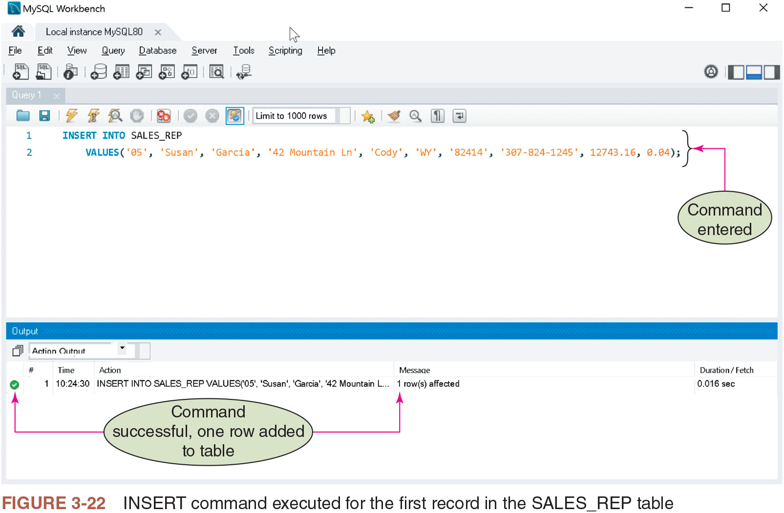
Figure 3-22: INSERT Command Executed for the First Record in the SALES_REP Table

Slide 37
Inserting a Row That Contains Nulls
Use a special format of INSERT command to enter a null value in a table
Identify the names of the columns that accept non-null values and then list only the non-null values after the VALUES command

Slide 38
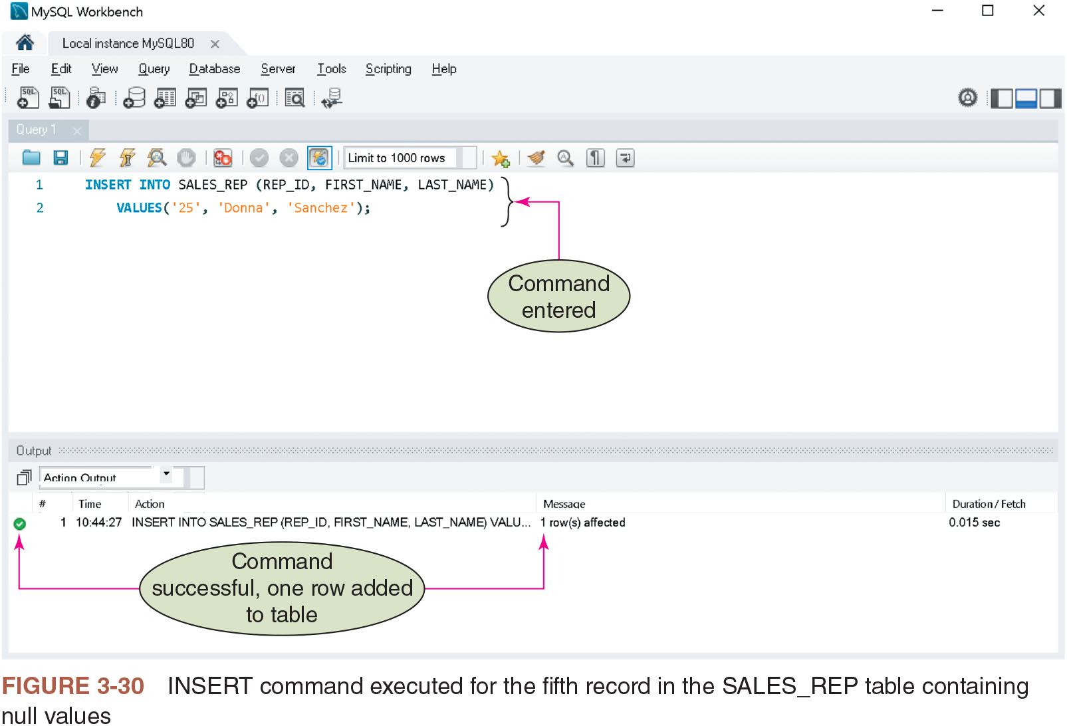
Figure 3-30: INSERT Command Executed for the Fifth Record in the SALES_REP Table Containing Null Values

Slide 39
Viewing Table Data
Use the SELECT command
Displays all the rows and columns in a table
Display all the rows and columns in the SALES_REP table
SELECT * FROM followed by the name of the table
End with a semicolon
In Oracle
Enter the statement followed by slash (/)
In S Q L Server
Enter SELECT statement in the Query Editor window

Slide 40
Correcting Errors in a Table
UPDATE, DELETE, and INSERT
UPDATE command is used to change a value in a table
DELETE is used to delete a row
INSERT is used to add a row

Slide 41
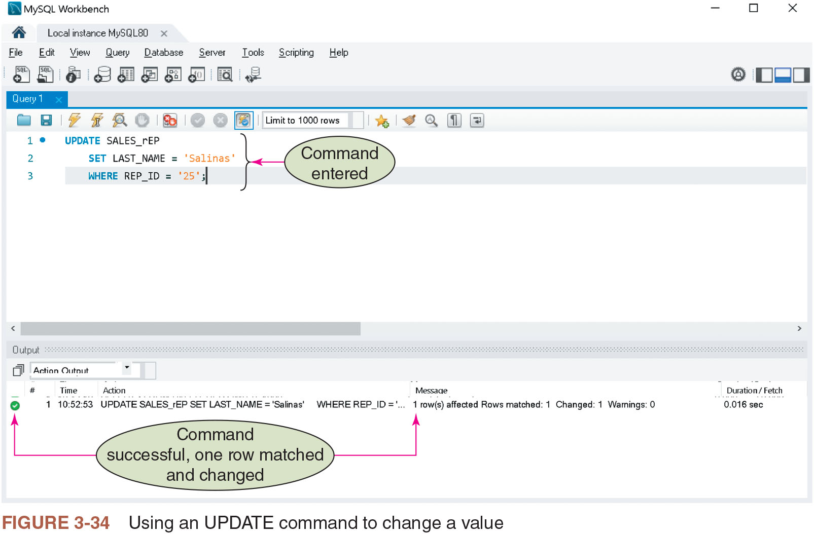
Figure 3-34: Using an UPDATE Command to Change a Value

Slide 42
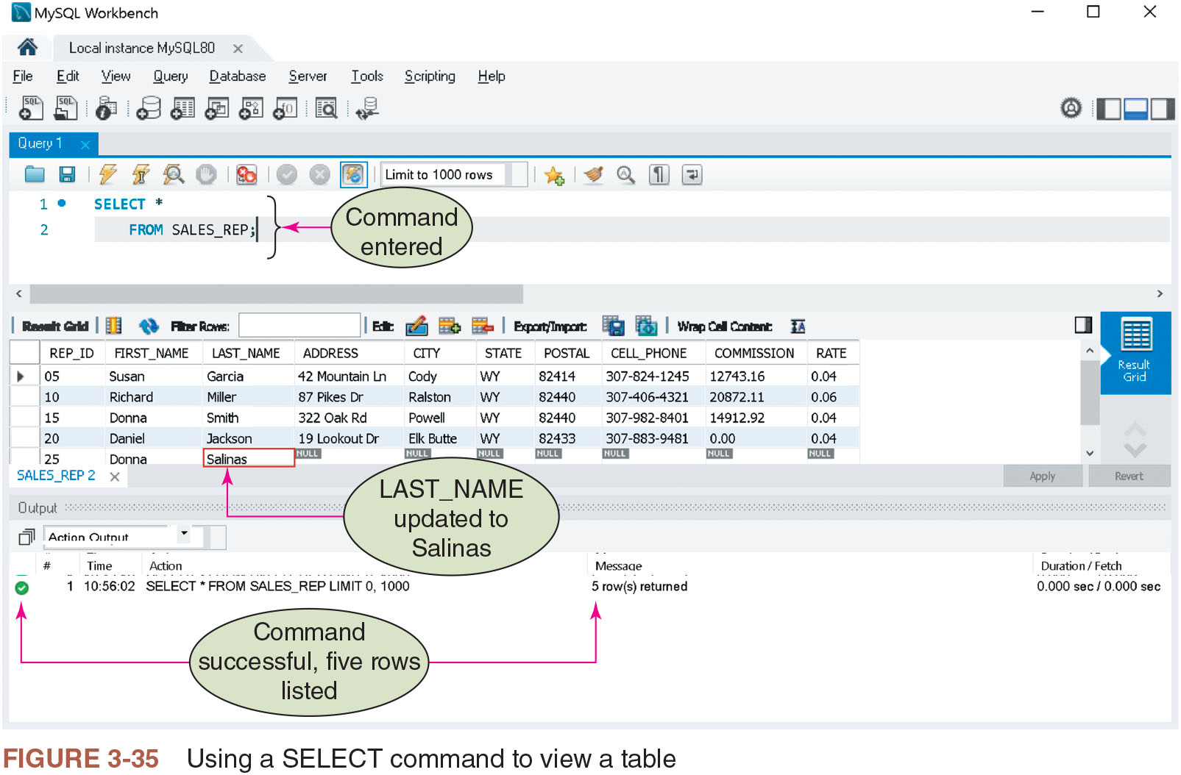
Figure 3-35: Using a SELECT Command to View a Table

Slide 43
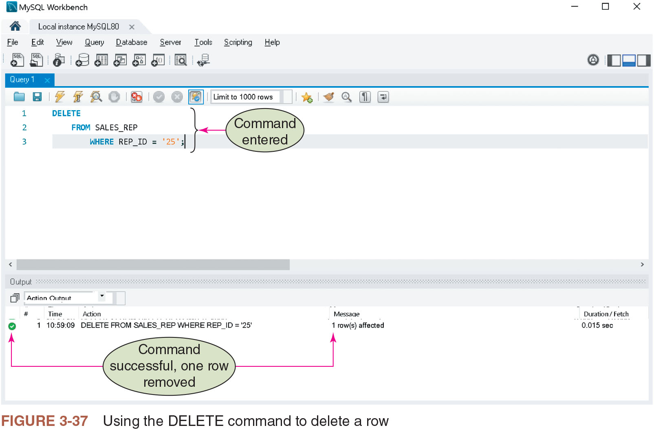
Figure 3-37: Using the DELETE Command to Delete a Row

Slide 44
Saving S Q L Commands (1 of 6)
Allows the use of commands repeatedly without retyping them
Commands are saved in a script file or script
Text file with .s q l extension
Script repository
Available in some database management systems such as Oracle
Specific location on local drive is used to download scripts

Slide 45
Saving S Q L Commands (2 of 6)
To create and save a script in My S Q L
Enter the command, or commands, that would comprise the script in the query pane
On the My S Q L Workbench main menu, click on the File menu and select the Save Script As option
Navigate to a location in the file system where the file has to be saved
Enter a name for the script in the File name
Click the Save button
To view, edit, or run a script in My S Q L
On the My S Q L Workbench main menu, click on the File menu and select Open S Q L Script
Navigate to the location in the file system where the script is saved

Slide 46
Saving S Q L Commands (3 of 6)
Select the script and click Open
Selected script is now in a new tab in the query pane without any change in the name of the script and can now be edited or run by choosing one of the two options below:
Execute by clicking Query on the My S Q L Workbench main menu and selecting the appropriate execute option
In the Run S Q L Script dialog box, select the Default Schema Name from the drop-down menu and click Run
Click on Close to close the Run S Q L Script dialog box after the results are displayed
To delete a script in My S Q L
Navigate to the location in the file system where the script is saved
Delete the file containing the script

Slide 47
Saving S Q L Commands (4 of 6)
To create a script file in Oracle S Q L Developer
Load the Oracle S Q L Developer tool
Enter query statement to be stored and execute it
Click the Save button and then enter a name for the script
To view, edit, or run an existing script in Oracle S Q L Developer
Load Oracle S Q L Developer and double click on Database Connection
Click the Open File button on the toolbar
Navigate to the folder containing the script file and then click the Open button in the Open File dialog box
Make edits and click the Save button to save changes
To run a script, click the Execute button

Slide 48
Saving S Q L Commands (5 of 6)
To create a script file in S Q L Server
Load S Q L Server Management Studio and then click the Connect button in the Connect to Server dialog box
Open the appropriate database and then click the New Query button
Type the command or commands to save in the script
When necessary, click the Execute button to execute the commands saved in the script
Click the Save button and then enter a name for the script

Slide 49
Saving S Q L Commands (6 of 6)
To view, edit, or run an existing script in S Q L server
Load S Q L Server Management Studio and then click the Connect button in the Connect to Server dialog box
Open the appropriate database and then click the New Query button
Click the Open File button on the toolbar
Navigate to the folder containing the script file and then click the Open button in the Open File dialog box
Click the Save button to save any changes made
Click the Execute button to run the script

Slide 50
Creating the Remaining Database Tables
Execute appropriate CREATE TABLE and INSERT commands
Save these commands as scripts
Separate multiple commands in a script file with a semicolon
Figures 3-39 through 3-46 give additional table information for KimTay Pet Supplies

Slide 51
Describing a Table
Involves using the DESCRIBE command
DESC in also accepted in My S Q L and Oracle
SP_COLUMNS in S Q L Server

Slide 52
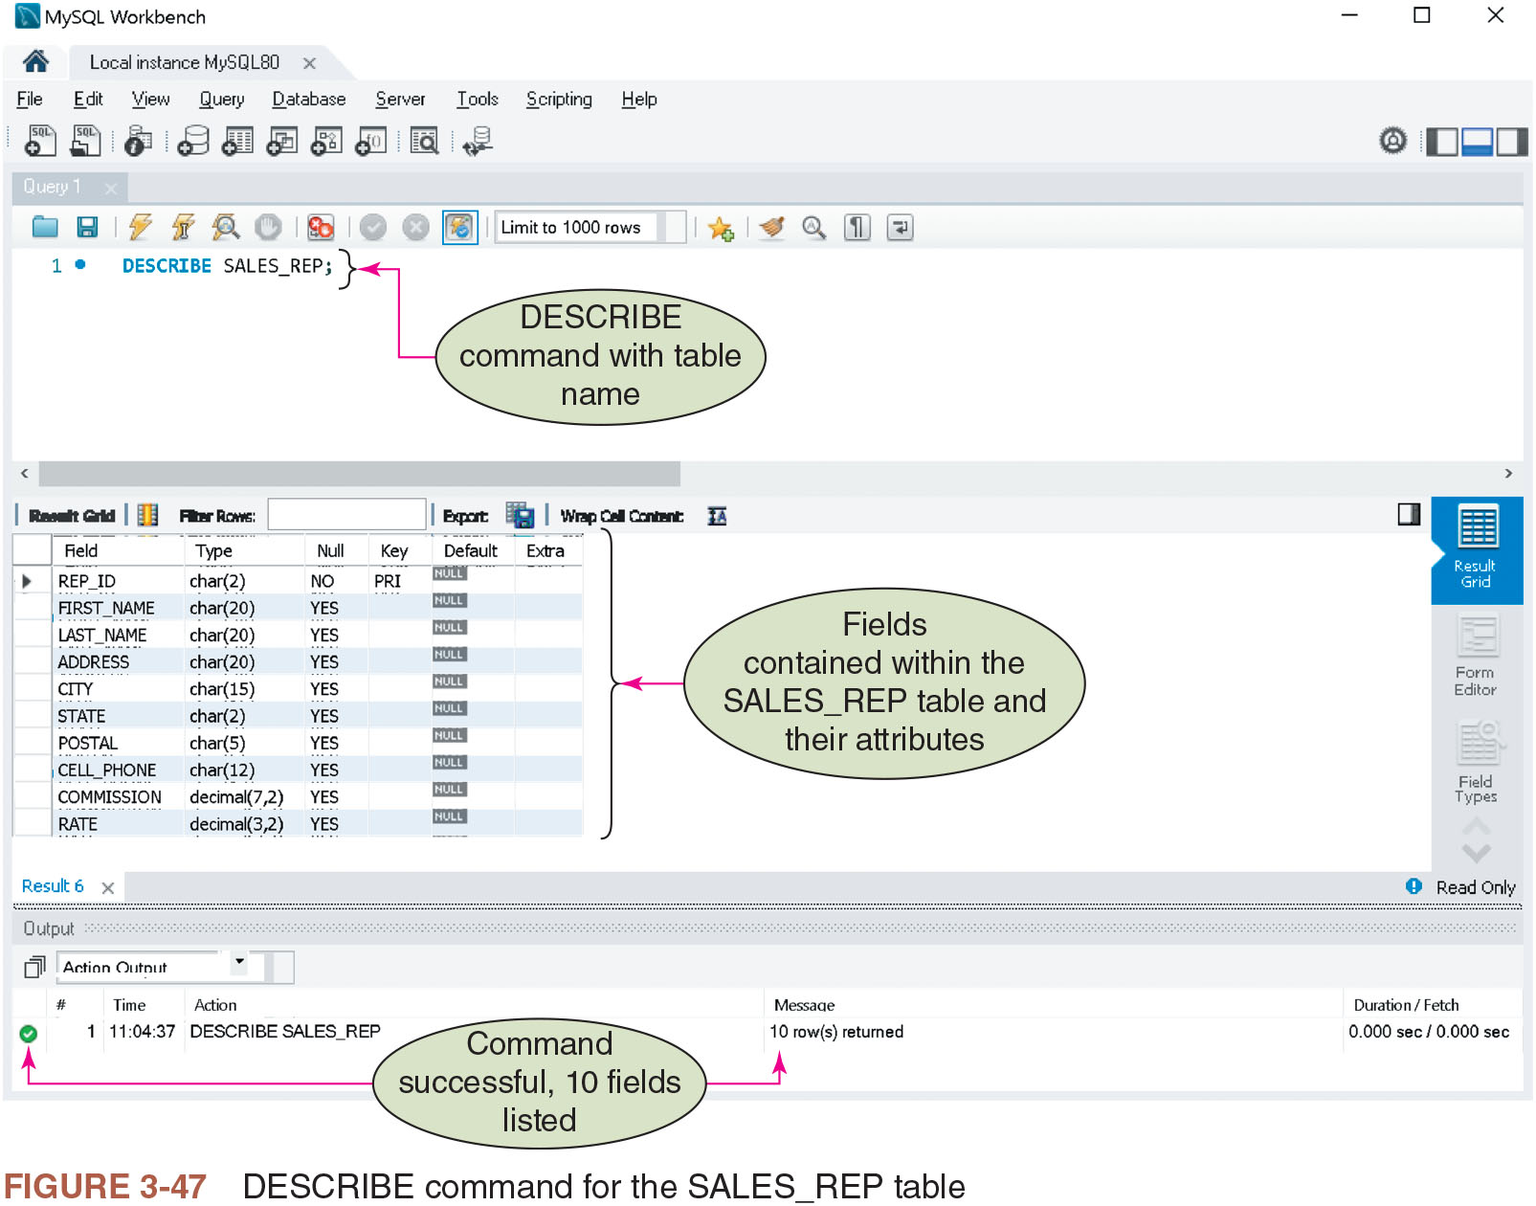
Figure 3-47: DESCRIBE Command for the SALES_REP Table

Slide 53
Summary (1 of 2)
Use the CREATE TABLE command to create tables
Use the DROP TABLE command to delete a table
CHAR, VARCHAR, DATE, DECIMAL, INT, and SMALLINT are commonly used data types
Null value is used when an actual value for a column is unknown, unavailable, or not applicable
Use the NOT Null clause to identify columns that cannot accept a null value
Use the INSERT command to add rows in a table
Use the SELECT command to view data in a table

Slide 54
Summary (2 of 2)
Use the UPDATE command to change the value in a column
Use the DELETE command to delete a row from a table
S Q L commands in a script file can be saved in My S Q L, Oracle, and S Q L Server
The DESCRIBE command in My S Q L and Oracle can be used to display a table’s structure and layout, and SP_COLUMNS in S Q L Server

